Slide 1
Making WebSockets Less Socket-y
And MORE AWESOME-y
By Luis Carlos Osorio Jayk

Slide 2
Table of contents
01
02
03
04
05
06
07
08
09
The issue
STATUS QUO
THe DEAL
AUTHorization
The numbers
Design patterns
The next
Demo
questions?

Slide 3
The issue?
What’s

Slide 4

POLLING
Is
inefficient
WEBsockets
Are
complex
LOT OF
BACKEND
CODE
REAlity is
Traditional real-time solution architectures require heavy lifting.

Slide 5
THE OPTIONS?
What are

Slide 6
AWS API Gateway
WebSockets
AWS IOT CORE
AWS APPSYNC
GRAPHQL
DEspite
They’re serverless, but none is an easy and straightforward setup

Slide 7
The deal?
What’s

Slide 8
AWS APPSYNC
Events
CREATE
REDUCE
Operation overhead
Real-time experiences in minutes
An easier way to build
and scale real-time experiences
Boost
LOWER
Application performance
Total costs

Slide 9
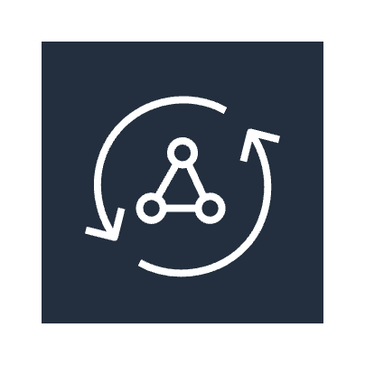




AWS APPSYNC Events PUB / SUB model
Namespace/channel/segment
Application clients
Application clients
Event-driven services
Event-driven services
Appsync event api
Publishers
WEBSOCKETs
SUBSCRIBERS

Slide 10
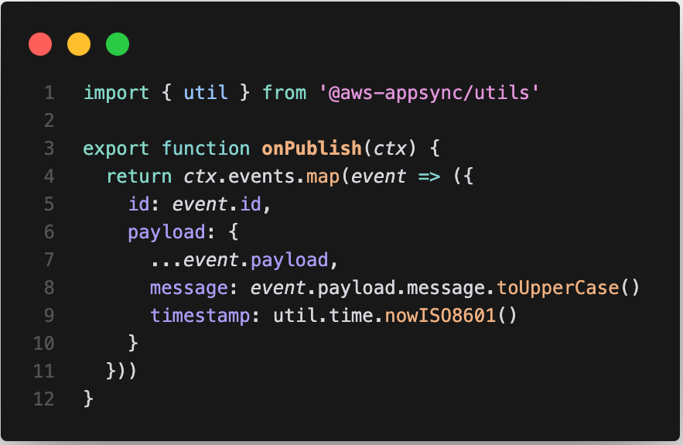
Namespace event handlers : onPublish

Slide 11
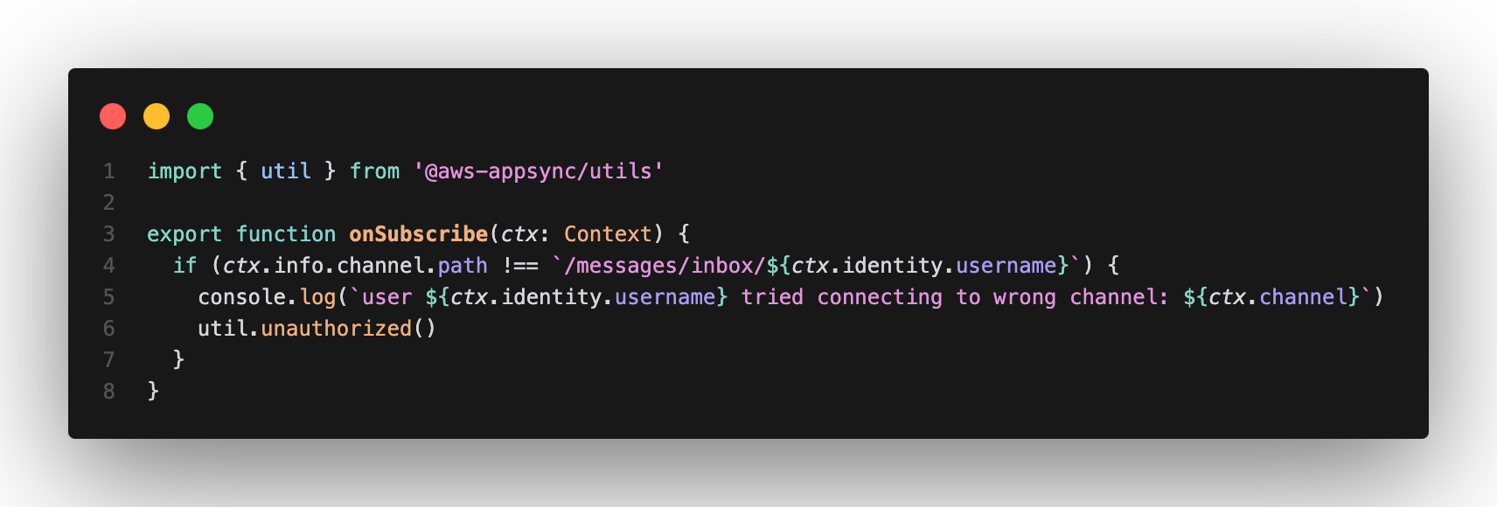
Namespace event handlers : onSubscribe

Slide 12
Authorization

Slide 13

01
02
03
04
05
API KEY
AMAZON
COGNITO
AWS LAMBDA
OPENID
CONNECT
AWS IAM

Slide 14
Pricing
and
Quotas

Slide 15
Outbound messages
INBOUND MESSAGES
NEW CONNECTIONS
1,000,000
10,000
2,000
QUOTAS
per second (adjustable)
per second (adjustable)
per second (adjustable)
API OPERATION COST
CONNECTION COST
FREE TIER
$ 1
$ 0,08
250,000
PRICING
per million operations
per million minutes
Operations and minutes per month, for 12 months
30
globally
REGIONS

Slide 16
DESIGN PATTERNS

Slide 17

Event Broadcast
pattern
/scores
/league/game/123
/league/teamA
/league/teamB
DynamoDB Streams
Lambda function
Application clients
AppSync Event API
Sports scores and stats to fan apps, TV
broadcast

Slide 18
Event Collaboration
pattern
/scoreboard
/game/123
/game/456
Application clients
Application clients
AppSync Event API
One versus one game play
CLIENTS ⇔ CLIENTS

Slide 19


Event persistence
RDS
API Gateway
Application clients
Application clients
AppSync Event API
Client subscribe only to subsequent updates
Adds storage

Slide 20
NEXT?
What’s

Slide 21
PRIVATE
PUBLISH
LAMBDA
Built-in
Event APIs
via WebSockets
Handlers
Targets
EVENT
BUILT-IN
PRESENCE
Event
Persistence
Order
Detection
Schemas

Slide 22
demo
The

Slide 23

https://appsync-chat.luisk.dev
Code available at:
https://github.com/luiscarlosjayk/app-sync-chat

Slide 24
QUESTIONS?
THANKS
luiscarlososoriojayk

